Slide 1
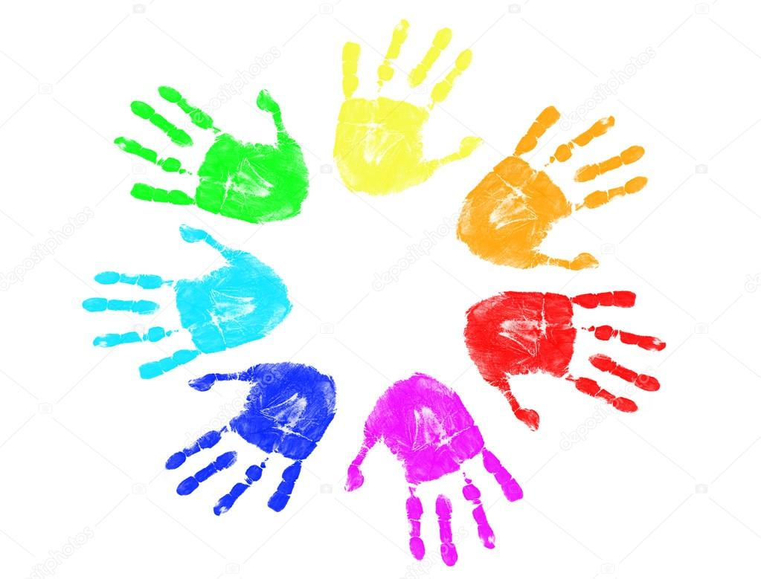
Different people, different talents
“We may have different religions, different languages, different coloured skins, but we all belong to one human race.” Kofi Annan

Slide 2
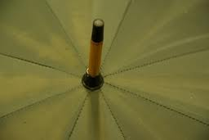
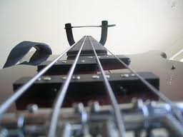
Guess what this is?
Notes:
A green umbrella a bass guitar

Slide 3
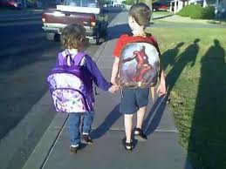
What Makes Me
Who am I?
What makes me?
The colours I wear
Or the films I see?
The words I say
Or the games I play?
The food I eat
Or the friends I meet?
The pets I keep
Or the room where I sleep?
The hair on my head
Or the toys on my bed?
The way I climb a tree
Or the scar on my knee?
The shape of my clothes
Or the size of my nose?
The way I run fast
Or the secrets in my past
If I’m scruffy or smart
Or what I feel in my heart?
The hand in my glove
Or the people I love?
Who am I?
What makes me?
The things I hide
Or the things you see?

Slide 4
Boys Equal Girls
Football SPORTS Netball
Action Man TOYS Barbie

Slide 5
What Makes Me illustrated by …………………………………….
Who am I?
What makes me?
The colours I wear
Or the films I see?
The words I say
Or the games I play?
The food I eat
Or the friends I meet?
The pets I keep
Or the room where I sleep?
The hair on my head
Or the toys on my bed?
The way I climb a tree
Or the scar on my knee?
The shape of my clothes
Or the size of my nose?
The way I run fast
Or the secrets in my past
If I’m scruffy or smart
Or what I feel in my heart?
The hand in my glove
Or the people I love?
Who am I?
What makes me?
The things I hide
Or the things you see?

